Slide 1
ICT Investment Trends in Hong Kong
November 2018

Slide 2
Contents
Executive summary
Enterprise ICT Investment Strategy in 2017
Segment ICT Budget Allocations – 2017 vs. 2018
Future Outlook – Enterprise Technology Priorities
Future Outlook – Technology Investment Priorities
Key findings
Survey Demographics
Enterprise Network & Communication Services Spend by Segment
ICT Spend for Managed IT Services - Breakdown by Segment
Software ICT Spend - Breakdown by Segment
Hardware ICT Spend - Breakdown by Segment
Future Outlook – Outsourcing Priorities for Select IT Functions
ICT - Vendor Analysis
Appendix
Enterprise ICT Budget Allocations – 2017 vs. 2018

Slide 3
Executive Summary

Slide 4
Key Findings
Enterprise ICT Investment Strategy in 2017
Enterprises in Hong Kong identify ‘improving operational efficiency’ as the most important business objective influencing their ICT investment strategy.
Production, procurement, and operations’ business function account for the largest share of total enterprise ICT spending among enterprises in Hong Kong .
Most survey respondents confirm that technology purchase decisions in their enterprises are taken jointly by all parties involved.
Enterprise ICT Budget Allocations – 2017 vs. 2018
According to GlobalData’s survey, about 48% of respondents say their enterprises are planning to increase (either slightly or significantly) their total ICT budget in 2017-2018 compared to percentage of respondents who planned to increase their ICT budget in 2016-2017.
Technology vendors are expected to account for the largest share of enterprise ICT budget in 2018, higher than the share the accounted for in 2017.
Data center IT function will account for the largest share of enterprise ICT spending among enterprises in Hong Kong in 2018.
Segment ICT Budget Allocations – 2017 vs. 2018
Hardware will attract most of enterprise ICT budget followed by software in 2018.
According to GlobalData’s survey, ‘security equipment’ and ‘network equipment’ will account for the largest share of total enterprise hardware spending among enterprises in Hong Kong in 2018.
‘Enterprise applications’ is the top pick for software investments among enterprises in Hong Kong in 2018.
Future Outlook – Enterprise Technology Priorities
SaaS and IaaS will be the investment of choice for most of respondents over the next two years among enterprises in Hong Kong. The survey further highlights that enterprises in Hong Kong will allocate the highest proportion of their cloud computing budget to cloud migration in the next two years.
With regards to IoT investments, ‘network sensors’, ‘supervisory control and data acquisition (SCADA)’, and ‘LPWAN’ will be the IoT hardware, software, and connectivity investments of choice for most enterprises in Hong Kong in the next two years.
GlobalData’s survey indicates that most respondents in Hong Kong consider that their enterprises are outsourcing their key IT functions now.
ICT Vendor Analysis
While Cisco is the preferred choice of vendor for cloud computing for majority of enterprises, AT&T is the preferred choice of vendor for IoT for most enterprises in Hong Kong.
Enterprises identify ‘customer service/quality’ and ‘expertise in the given industry’ as main criteria for selection of ICT provider.

Slide 5
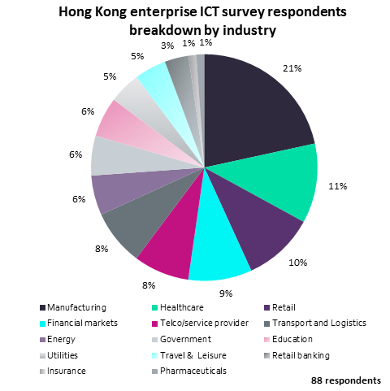
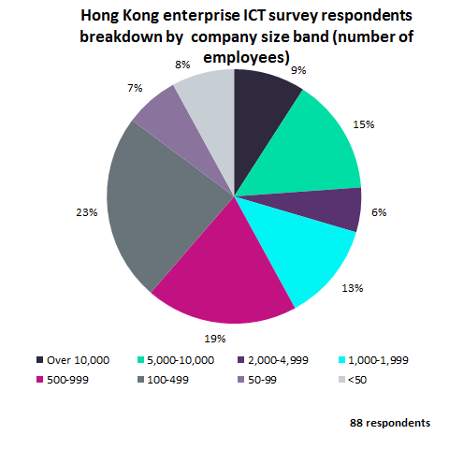
Survey demographics
Breakdown of survey respondents by industry and by company size

Slide 6
Enterprise ICT Investment Strategy in 2017

Slide 7
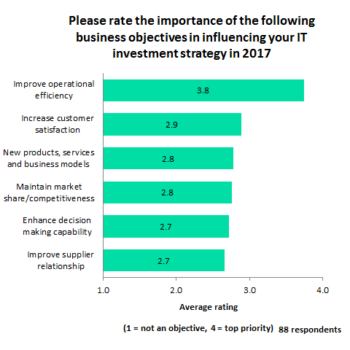
Key business objectives influencing enterprise ICT investments
Most enterprises give highest average rating to ‘improving operational efficiency’ as a business objective influencing their IT investment strategy
According to GlobalData’s survey, in Hong Kong , the business objective - ‘improving operational efficiency’ received the highest average rating 3.8 on a scale of one to four from enterprises in 2017, with regard to its importance in influencing their IT investment strategy.
The business objective to ‘increase customer satisfaction’ received the second highest average rating of 2.9.
The business objective to develop ‘new products, services and business models’ and maintaining ‘market share/competitiveness’ received an average rating of 2.8 each.
Meanwhile, the business objective - ability to ‘enhance decision making capabilities’ and helping ‘improve supplier relationships’ received an average rating of 2.7 each.

Slide 8
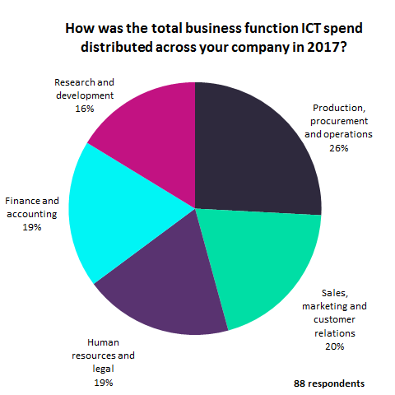
Breakdown of enterprise ICT spend by business function
The largest share of enterprise ICT spending in Hong Kong is allocated to ‘production, procurement, and operations’ business function followed by ‘sales, marketing, and customer relations’ business function
According to GlobalData’s survey,’ in Hong Kong ‘production, procurement, and operations’ business function accounted for the largest share 26% of total enterprise ICT spending in 2017.
‘sales, marketing, and customer relations’ business function accounted for the second largest share (20%) of their total enterprise ICT spending in 2017.
‘Human resources and legal’ and ‘finance and accounting’ business functions accounted for the third largest share (19%) each of total enterprise ICT spending in 2017.
‘Research and development’ business function accounted for the fourth largest share (16%) of total enterprise ICT spending in 2017.

Slide 9
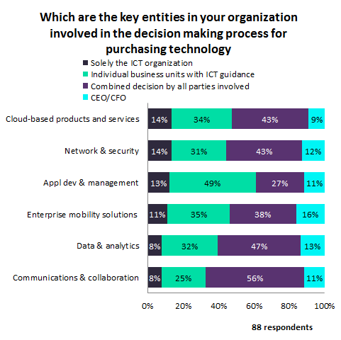
Key decision makers for enterprise technology investments
Most technology purchase decisions in enterprises are jointly taken by all parties involved
GlobalData’s survey indicates that the technology purchase decisions in enterprises in Hong Kong are mostly taken jointly by all parties involved.
About 56% of respondents claim that their technology purchase decision for ‘communications & collaboration’ is taken jointly by all parties involved.
About 47% claim that their technology purchase decision for ‘data & analytics’ is taken jointly by all parties involved and about 43% of respondents each claim that their technology purchase decision for ‘network & security’ and ‘cloud-based products and services’ are taken jointly by all parties involved.
Meanwhile, the second most technology purchase decisions in enterprises in Hong Kong are mostly taken by individual business units with ICT guidance. About 49% claim that their technology purchase decision for ‘application development and management’ is taken by individual business units with ICT guidance.

Slide 10
Enterprise ICT Budget Allocations – 2017 vs. 2018

Slide 11
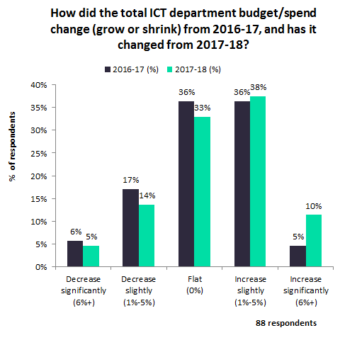
Annual change in enterprise ICT budget allocation
Most of the enterprises in Hong Kong continue to increase their budget slightly, but many are also expected to keep their ICT budget flat in 2018
Hong Kong witnesses a healthy domestic demand and is an important financial and banking hub in the Asia Pacific. The government’s Digital 21 strategy is one of the key initiatives in promoting ICT adoption. Some of the key e-government initiatives include ‘GovHK’ (a one-stop government portal) and citizen-centric online services among others.
According to GlobalData’s survey,38% of respondents in Hong Kong said they would see a slight increase in their ICT spending in 2017-2018, an increase of 2 p.p. over the percentage of respondents who planned to do the same in 2016-2017.
About 10% said they would see significant increase in their ICT spending in 2017-2018, an increase of 5 p.p. over the percentage of respondents who planned to do the same in 2016-2017.
About 33% are planning to keep their ICT expenditure flat in 2017-2018. This is however lower than the 36% of respondents who kept their ICT investments flat in 2016-2017.
About 14% are however planning to reduce their ICT spending slightly in 2017-2018, while 5% of respondents are planning to reduce their ICT spending significantly in 2017-2018. This is however lower than the percentage of respondents who planned to do the same in 2016-2017.

Slide 12
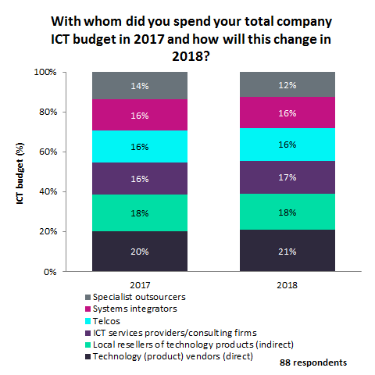
Annual change in distribution of enterprise ICT budget by vendor type
Technology vendors will account for major share of enterprise ICT spend in 2018, followed by local resellers of technology products
According to GlobalData’s survey, in Hong Kong ‘technology vendors’ would account for the largest share 21% of total enterprise ICT spending in 2018, which is 1 p.p. more than their share of ICT spending in 2017.
‘Local resellers of technology products’ will account for the second largest share 18% of total enterprise ICT spending in 2018, which is the same share as in 2017.
‘ICT services providers/consulting firms’ will account for the third largest share 17% of total enterprise ICT spending in 2018, which is 1 p.p. more than their share of ICT spending in 2017.
‘Telcos’ and ‘systems integrators’ will account for 16% share each of total enterprise ICT spending in 2018, which is the same share as in 2017.
‘Specialist outsourcers’ on the other hand would account for 12% share of total enterprise ICT spending in 2018, which is 2 p.p. less than their share of ICT spending in 2017.

Slide 13
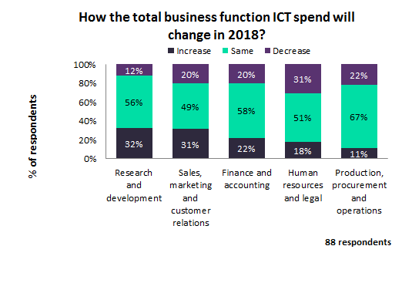
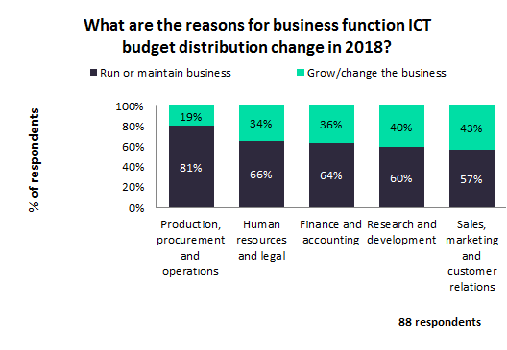
Annual change in enterprise ICT budget for key business functions
Enterprise ICT budget allocations across all business functions is mostly to ‘run or maintain business’
GlobalData’s survey indicates that enterprise ICT spending in Hong Kong will mostly remain same in 2018 compared to 2017.
The largest proportion (67%) of survey respondents in Hong Kong claim that their ICT spending on ‘production, procurement, and operations’ business function in 2018 will remain same as in 2017, and about 22% claim that their ICT spending on this function will decrease in 2018 compared to 2017.
About 32% claim that they would increase their ICT spend on ‘research and development’ business function in 2018 and about 56% claim that ICT spending on this business function in 2018 will remain same as in 2017.
GlobalData’s survey in Hong Kong finds that the most prominent purpose of enterprise ICT spending in 2018 will be for ‘running or maintaining businesses’.
The largest proportion 81% of respondents consider that their ICT spending on ‘production, procurement, and operations’ business function will be used to run or maintain business in 2018, and about 19% claim that their ICT spending on this function will be to grow the business in 2018. Meanwhile, about 43% consider that their ICT spending on ‘sales, marketing, and customer relations’ business function will be to grow/change the business in 2018.

Slide 14
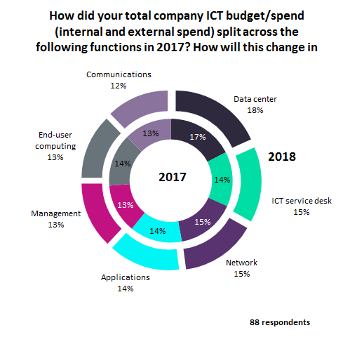
Annual change in distribution of enterprise ICT budget by ICT functions
Highest proportion of enterprise ICT budget to be spent on data center followed by ICT service desk and network functions in 2018
According to GlobalData’s survey in Hong Kong, ‘data center’ function will account for the largest share 18% of total enterprise ICT spending in 2018, an increase of 1 p.p. over its share in 2017.
‘ICT service desk’ and ‘network’ will account for the second largest share 15% share each of total enterprise ICT spending in 2018. While the percentage of enterprise ICT spending on ‘ICT service desk’ in Hong Kong will increase by 1 p.p. over the percentage share it accounted for in 2017, the percentage of enterprise ICT spending on the ‘network’ function in Hong Kong will remain same share as in 2017.
‘Applications’ function will account for the third largest share 14% of total enterprise ICT spending in 2018, maintaining the same share as in 2017.
“Management’ and ‘end-user computing’ business functions will account for 13% share each of total enterprise ICT spending in 2018. While the percentage of enterprise ICT spending on the ‘management’ function in Hong Kong will remain same as the percentage it accounted for in the previous year, the percentage of enterprise ICT spending on ‘end-user computing’ in Hong Kong will drop by 1 p.p. from 2017.
‘Communications’ function will account for 12% share of total enterprise ICT spending in 2018, a drop of 1 p.p. from 2017.

Slide 15
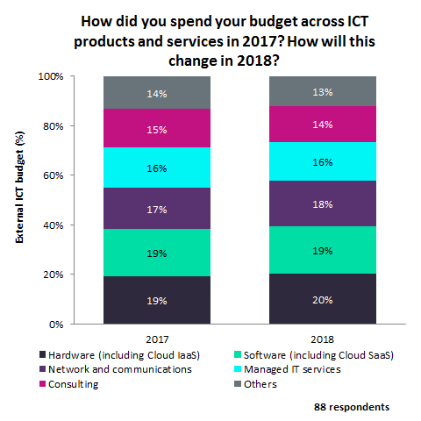
Annual change in distribution of enterprise ICT budget by segment
Hardware to account for the largest share of ICT budget allocations among enterprises in Hong Kong for 2018
According to GlobalData’s survey in Hong Kong, hardware will account for the largest share (20%) of total enterprise ICT spending in 2018, an increase of 1 p.p. over its share of ICT spending it accounted for in 2017.
Software will account for the second largest share (19%) of total enterprise ICT spending in 2018, the same share as in 2017.
Network and communications will account for the third largest share (18%) of total enterprise ICT spending in 2018, an increase of 1 p.p. over its share in 2017.
Managed IT services will account for 16% share of total enterprise ICT spending in 2018, the same share as in 2017.
Consulting will account for a 14% share of total enterprise ICT spending in 2018, a decline of 1 p.p. from its share in 2017.

Slide 16
Segment ICT Budget Allocations – 2017 vs. 2018

Slide 17
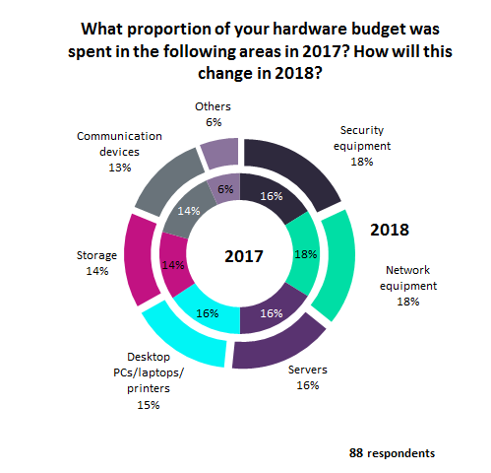
Annual change in enterprise hardware budget allocations
‘Security’ & ‘network’ equipment to account for largest proportion of enterprise hardware expenditure budget in Hong Kong in 2018
According to GlobalData’s survey in Hong Kong, ‘security equipment’ and ‘network equipment’ will each account for the largest share 18% of total enterprise hardware spending in 2018. While the percentage of enterprise hardware spending on ‘security equipment’ in Hong Kong will increase by 2 p.p. over the percentage share it accounted for in 2017, the percentage of enterprise hardware spending on the ‘network equipment’ in Hong Kong will remain same as the percentage it accounted for in the previous year.
‘Servers’ will account for the second largest share 16% of total enterprise hardware spending in 2018, which is the same proportion of total enterprise hardware spending it accounted for in 2017. ‘Desktop PCs/laptops/printers’ will account for a 15% share of total enterprise hardware spending in 2018, a decrease of 1 p.p. from its share in 2017. ‘Storage’ will account for a 14% share of total enterprise hardware spending in 2018, which is the same proportion of total enterprise hardware spending it accounted for in 2017, while ‘communication devices’ will account for a 13% share of total enterprise hardware spending in 2018.

Slide 18
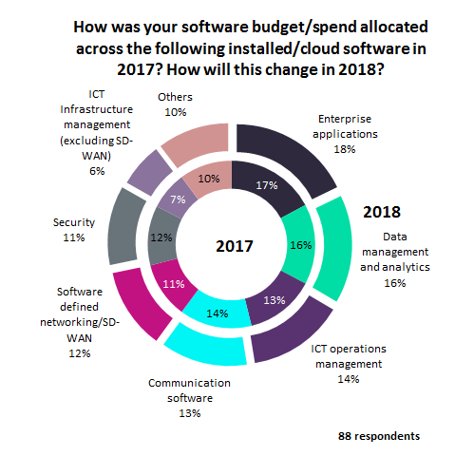
Annual change in enterprise software budget allocations
Enterprise applications will account for the largest share of total enterprise software spending in 2018
According to GlobalData’s survey in Hong Kong, ‘enterprise applications’ will account for the largest share (18%) of the total enterprise software spending in 2018, an increase of 1 p.p. over its share in 2017.
‘Data management and analytics’ will account for the second largest share (16%) of total enterprise software spending in 2018, which is the same share as in 2017.
‘ICT operations management’ will account for the third largest share (14%) of the total enterprise software spending in 2018, an increase of 1 p.p. over its share in 2017.
‘Communication software’ will account for a 13% share of total enterprise software spending in 2018, a decrease of 1 p.p. from 2017.
‘Software defined networking/SD–WAN’ will account for a 12% share of total enterprise software spending in 2018, an increase of 1 p.p. over in 2017.
‘Security’ will account for a 11% share of total enterprise software spending in 2018, a decrease of 1 p.p. from 2017.
‘ICT infrastructure management’ will account for 6% share of total enterprise software spending in 2018, a decrease of 1 p.p. from 2017.

Slide 19
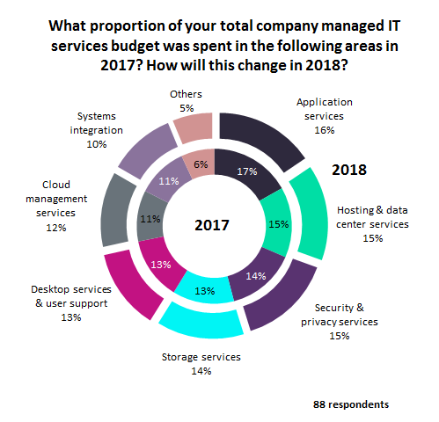
Annual change in enterprise managed IT service budget allocations
Application services will account for the largest share of managed IT services budget among enterprises in 2018
According to GlobalData’s survey in Hong Kong, ‘application services’ will account for the largest share 16% of total enterprise managed IT services spending in 2018, a decrease of 1 p.p. from its share in 2017.
‘Hosting & data center services’ and ‘security & privacy services’ will each account for the second largest share (15%) of total enterprise managed IT services spending in 2018. While the percentage of total enterprise managed IT services spending on the ‘hosting & data center services’ in Hong Kong will remain same from previous year, the percentage of total enterprise managed IT services spending on ‘security & privacy services’will increase by 1 p.p. over in 2017.
‘Storage services’ will account for a 14% share of total enterprise managed IT services spending in 2018, an increase of 1 p.p. over in 2017.
‘Desktop services & user support’ will account for a 13% share of total enterprise managed IT services spending in 2018, which is the same share as in 2017.
‘Cloud management services’ will account for a 12% share of total enterprise managed IT services spending in 2018, an increase of 1 p.p. over in 2017.
‘Systems integration’ will account for a 10% share of total enterprise managed IT services spending in 2018, a decrease of 1 p.p. from 2017.

Slide 20
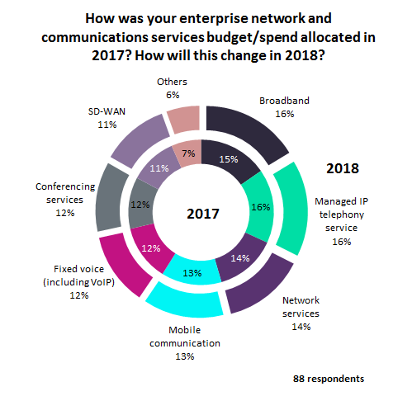
Annual change in enterprise network & communication services budget allocations
‘Broadband’ and ‘managed IP telephony service’ to attract largest share of enterprise network & communications services budget in 2018
According to GlobalData’s survey in Hong Kong ‘broadband’ and ‘managed IP telephony service’ will each account for the largest share 16% of total enterprise network & communications services spending in 2018. While the percentage of total enterprise network & communications services spending on the ‘broadband’ service in Hong Kong will increase by 1 p.p. over in 2017, the percentage of total network & communications services spending on ‘managed IP telephony service’ in Hong Kong will remain same share as in 2017.
‘Network services’ will account for the second largest share (14%) of total enterprise network & communications services spending in 2018, which is the same share as in 2017.
Mobile communication’ will account for the third largest share (13%) of total enterprise network & communications services spending in 2018, while maintaining the same share as in 2017.
‘Fixed voice’ and ‘conferencing services’ will account for a 12% share each of total enterprise network & communications services spending in 2018, while ‘SD-WAN’ will account for an 11% share of total enterprise network & communications services spending in 2018.

Slide 21
Future Outlook – Enterprise Technology Priorities

Slide 22
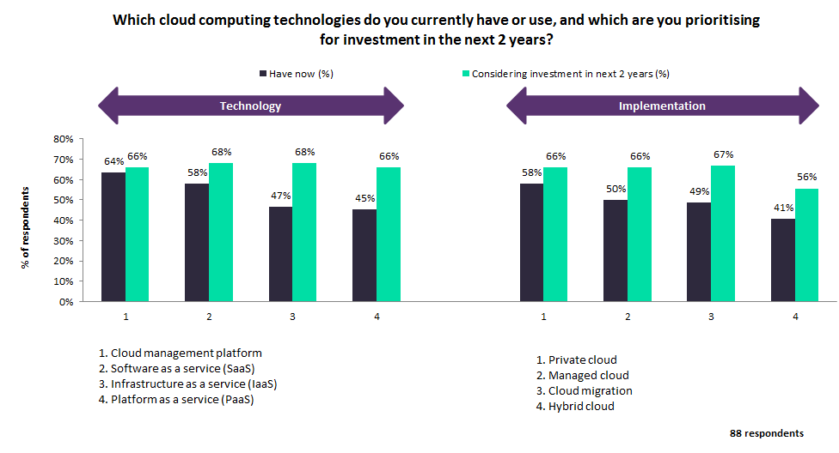
Enterprise investment priority for cloud computing - Now vs. next two years (1/2)

Slide 23
Enterprise investment priority for cloud computing - Now vs. next two years (2/2)
Currently most respondents consider ‘cloud management platform’ as their enterprise cloud computing investment, and ‘software as a service (SaaS)’ and ‘infrastructure as a service (IaaS)’ will attract investments from most enterprises over next two years
According to GlobalData’s survey, about 64% of respondents in Hong Kong confirm that their enterprises have already invested in cloud management platform for cloud computing, while 66% of respondents consider that their enterprises would invest in this cloud computing technology in the next two years.
About 58% say that their enterprises are currently investing in SaaS as a cloud computing technology, about 68% indicate that their enterprises are planning to invest in this cloud computing technology in the next two years.
About 68% from Hong Kong consider that their enterprises would invest in IaaS as a cloud computing technology in the next two years, while 47% confirm that their enterprise have already invested in this cloud computing technology.
With regard to implementation model, about 58% confirm that their enterprises have already invested in private cloud, while 66% consider their enterprises would invest in this cloud implementation model in next two years.
While 50% confirm that their enterprises have already invested in managed cloud, about 66% consider their enterprises would invest in this cloud implementation model in next two years.
About 56% consider their enterprises would invest in hybrid cloud in the next two years, while 41% confirm that their enterprises have already invested in this cloud implementation model.

Slide 24
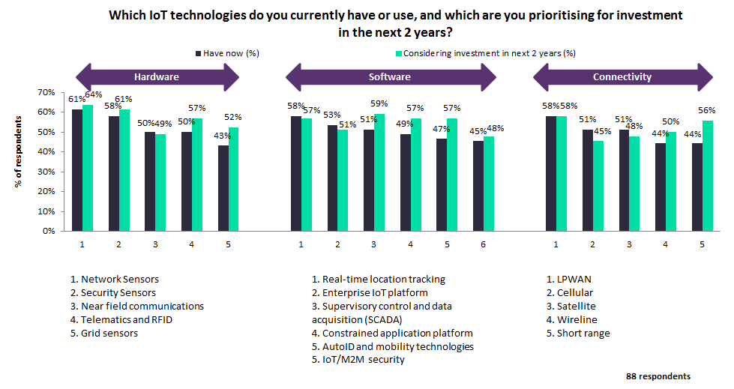
Enterprise investment priority for IoT - Now vs. next two years (1/2)

Slide 25
Enterprise investment priority for IoT - Now vs. next two years (2/2)
Currently ‘network sensors’ attract most IoT hardware investments, while ‘SCADA’ is the most prominent IoT software investment in the next two years
According to GlobalData’s survey, about 61% of respondents in Hong Kong confirm that their enterprises have already invested in network sensors for IoT, while 64% consider that their enterprises would invest in this hardware component in the next two years.
About 58% confirm that their enterprises have already invested in security sensors for IoT, while 61% consider that their enterprises would invest in this hardware component in the next two years.
With regard to software, about 58% in Hong Kong confirm that their enterprises have already invested in real-time location tracking, while 57% consider that their enterprises would invest in this software component in the next two years.
About 59% consider that their enterprises would invest in supervisory control and data acquisition (SCADA) in the next two years, while about 51% confirm that their enterprises have already invested in this software component.
With regard to connectivity, about 58% in Hong Kong confirm that their enterprises have already invested in enterprise LPWAN connectivity, while the same percentage consider that their enterprises would invest in this connectivity platform in the next two years.
About 51% in Hong Kong confirm that their enterprises have already invested in enterprise cellular connectivity, while 45% consider that their enterprises would invest in this connectivity platform in the next two years.

Slide 26
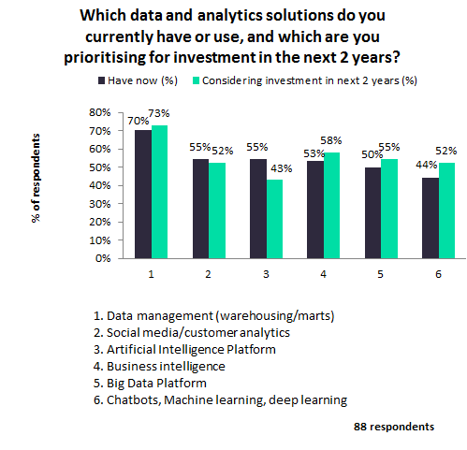
Enterprise investment priority for data and analytics solutions - Now vs. next two years
Data management (warehousing/marts) is the data and analytics solution that most enterprises have already invested in, and will be the popular investment target in next two years
According to GlobalData’s survey, about 70% of respondents in Hong Kong confirm that their enterprises have already invested in ‘data management’ as a data & analytics solution, while 73% consider that their enterprises would invest in this data & analytics solution in the next two years.
About 53% claim that their enterprises have already invested in ‘business intelligence’ as a data & analytics solution, while 58% consider that their enterprises would invest in this data & analytics solution in the next two years.
About 55% consider that their enterprises would consider investing in ‘big data platform’ as a data & analytics solution in the next two years, while 50% claim that their enterprises have already invested in this data & analytics solution.
About 52% consider that their enterprises would invest in ‘chatbots, machine learning, deep learning’ as a data & analytics solution in the next two years, while 44% claim that their enterprise have already invested in this data & analytics solution.

Slide 27
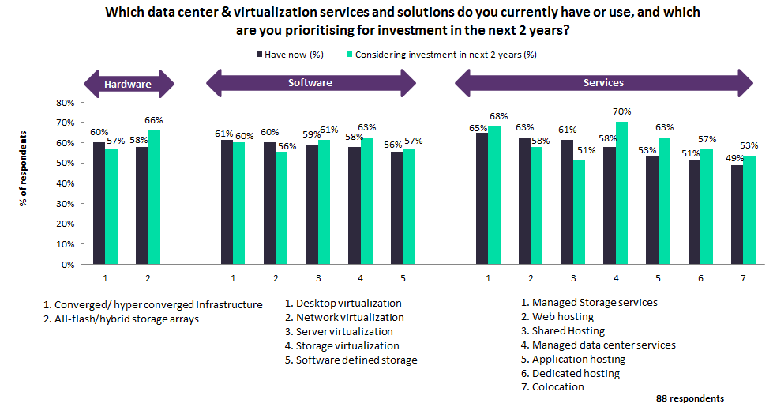
Enterprise investment priority for data center and virtualization services - Now vs. next two years (1/2)

Slide 28
Enterprise investment priority for data center and virtualization services - Now vs. next two years (2/2)
Currently ‘converged/hyper converged infrastructure’ attract most data center & virtualization hardware investments, while ‘storage virtualization’ is the most prominent data center & virtualization software investment in the next two years
According to GlobalData’s survey, about 60% of respondents in Hong Kong confirm that their enterprises have already invested in ‘converged/hyper converged infrastructure’ for data center & virtualization services, while 57% consider that their enterprises would invest in this hardware component in the next two years.
About 58% confirm that their enterprises have already invested in ‘all-flash/hybrid storage arrays’ for data center & virtualization services, while 66% consider that their enterprises would invest in this hardware component in the next two years.
With regard to software, about 61% confirm that their enterprises have already invested in ‘desktop virtualization‘, while 60% consider that their enterprises would invest in this software component in the next two years.
About 63% consider that their enterprises would invest in ‘storage virtualization’ in the next two years, while about 58% confirm that their enterprises have already invested in this software component.
With regard to services, about 65% confirm that their enterprises have already invested in ‘managed storage services’ for data center & virtualization, while 68% of respondents consider that their enterprises would invest in this services platform in the next two years.
About 58% confirm that their enterprises have already invested in ‘managed data center services’ for data center & virtualization, while 70% consider that their enterprises would invest in this service platform in the next two years.

Slide 29
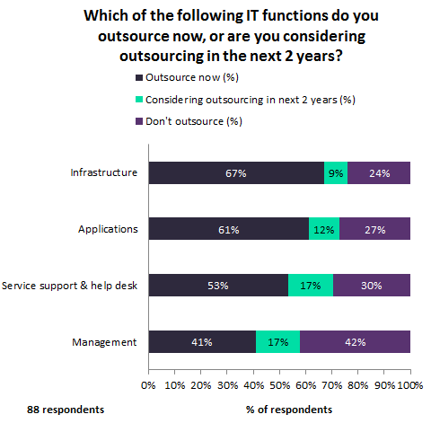
Enterprise priority for outsourcing key IT functions – Now vs. next two years
‘Infrastructure’ is the ICT function that most organizations in Hong Kong are outsourcing now, followed by ‘applications’ function
GlobalData’s survey indicates that most respondents from Hong Kong are outsourcing their key IT functions now.
About 67% of respondents from Hong Kong claim that they are already outsourcing their ‘infrastructure’ function now, while about 24% of respondents will prefer to carryout this function in-house.
About 61% claim that they are already outsourcing their ‘applications’ function now, while about 27% said they will not outsource their ‘applications’ function in the next two years.
About 53% claim that they are already outsourcing their ‘service support & help desk’ function now, while about 30% of respondents will prefer to carryout this function in-house.
Meanwhile, about 42% claim that they will prefer to carryout ‘management’ function in-house, while about 41% of respondents are already outsourcing this function now.

Slide 30
ICT - Vendor Analysis

Slide 31
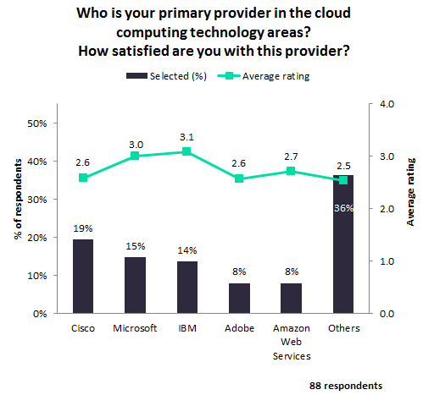
Most preferred cloud computing vendors for enterprises
Cisco is the most prominent cloud computing vendor among enterprises in Hong Kong
According to GlobalData’s survey, 19% of respondents in Hong Kong selected Cisco as their primary vendor for cloud computing, which is the largest percentage of votes for a vendor. The survey also shows that Cisco received a vendor satisfaction rating of 2.6 on a scale of one to four among enterprises.
About 15% selected Microsoft as their primary vendor for cloud computing, which is the second largest percentage of votes for a vendor. The survey shows that Microsoft received a vendor satisfaction rating of 3.0.
About 14% selected IBM as their primary vendor for cloud computing, which is the third largest percentage of votes for a vendor. The survey shows that IBM received the highest vendor satisfaction rating of 3.1.
About 8% selected Adobe and Amazon Web Services (AWS) each as their primary vendor for cloud computing, which is the fourth largest percentage of votes for a vendor. The survey shows that Adobe received a vendor satisfaction rating of 2.6, while AWS received a vendor satisfaction rating of 2.7.

Slide 32
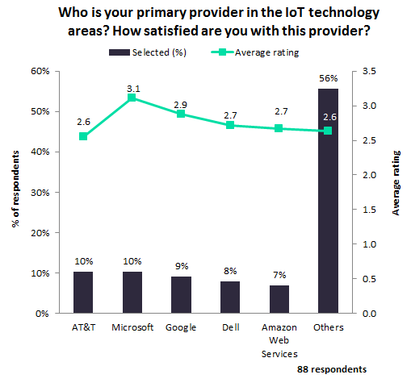
Most preferred IoT vendors for enterprises
AT&T represents the most prominent IoT vendor for enterprises in Hong Kong
According to GlobalData’s survey, 10% of respondents in Hong Kong selected AT&T and Microsoft each as their primary vendor for IoT, which is the largest percentage of votes for a vendor.
The survey shows that AT&T received a vendor satisfaction rating of 2.6, while Microsoft received the highest vendor satisfaction rating of 3.1 on a scale of one to four among enterprises.
About 9% selected Google as their primary vendor for IoT, which is the second largest percentage of votes for a vendor. The survey also shows that Google received a vendor satisfaction rating of 2.9.
About 8% selected Dell as their primary vendor for IoT, which is the third largest percentage of votes for a vendor. The survey also shows that Dell received a vendor satisfaction rating of 2.7.
About 7% selected Amazon Web Services as their primary vendor for IoT, which is the fourth largest percentage of votes for a vendor. The survey shows that Amazon Web Services also received a vendor satisfaction rating of 2.7.

Slide 33
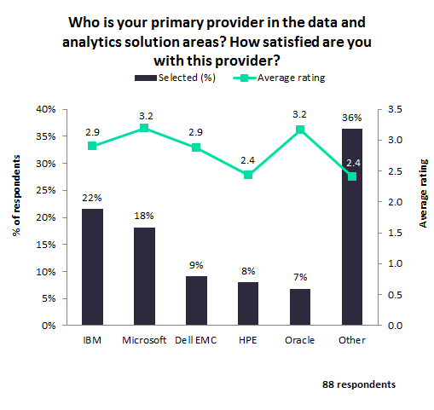
Most preferred data and analytics vendors for enterprises
IBM represents the leading vendor of data and analytics solution vendors for enterprises in Hong Kong
According to GlobalData’s survey, 22% of respondents in Hong Kong selected IBM as their primary vendor for data and analytics solution, which is the largest percentage of votes for a vendor.
The survey also shows that IBM received a vendor satisfaction rating of 2.9 on a scale of one to four among enterprises.
About 18% selected Microsoft as their primary vendor for data and analytics solution, which is the second largest percentage of votes for a vendor. The survey shows that Microsoft received the highest vendor satisfaction rating of 3.2.
About 9% selected Dell EMC as their primary vendor for data and analytics solution, which is the third largest percentage of votes for a vendor. The survey shows that Dell EMC received a vendor satisfaction rating of 2.9.
About 8% selected HPE as their primary vendor for data and analytics solution. The survey shows that HPE received a vendor satisfaction rating of 2.4.
About 7% selected Oracle as their primary vendor for data and analytics solution. The survey shows that Oracle also received the highest vendor satisfaction rating of 3.2.

Slide 34
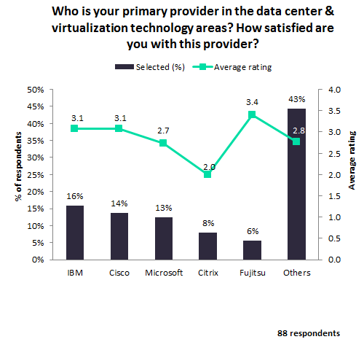
Most preferred data center & virtualization technology vendors for enterprises
IBM represents the leading vendor of data center & virtualization service vendors for enterprises in Hong Kong
According to GlobalData’s survey, 16% of respondents in Hong Kong selected IBM as their primary vendor for data center & virtualization technology, which is the largest percentage of votes for a vendor.
The survey also shows that IBM received a vendor satisfaction rating of 3.1 on a scale of one to four among enterprises.
About 14% selected Cisco as their primary vendor for data center & virtualization technology, which is the second largest percentage of votes for a vendor. The survey shows that Cisco received a vendor satisfaction rating of 3.1.
About 13% selected Microsoft as their primary vendor for data center & virtualization technology, which is the third largest percentage of votes for a vendor. The survey shows that Microsoft received a vendor satisfaction rating of 2.7.
About 8% selected Citrix as their primary vendor for data center & virtualization technology, which is the fourth largest percentage of votes for a vendor. The survey shows that Citrix received a vendor satisfaction rating of 2.0.
About 6% selected Fujitsu as their primary vendor for data center & virtualization technology, which is the fifth largest percentage of votes for a vendor. The survey shows that Fujitsu received the highest vendor satisfaction rating of 3.4.

Slide 35
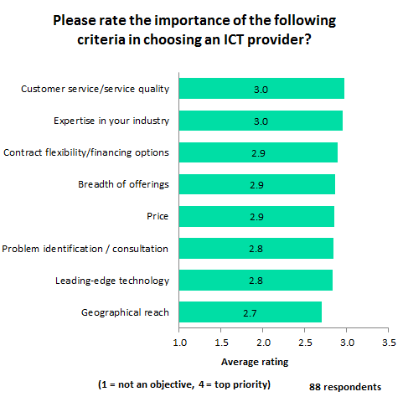
Important criteria for ICT vendor selection
‘Customer service/quality’ and ‘expertise in the given industry’ are the most important criteria when selecting an ICT provider
According to GlobalData’s survey, in Hong Kong, ability to provide - ’customer service/quality’ and ‘expertise in your industry’ received the highest average rating of 3.0 each on a scale of one to four from enterprises, with regard to their importance as a criteria for choosing ICT provider.
‘Contract flexibility/financing options’, ‘breadth of offerings’ and ‘pricing’ received the second highest average rating of 2.9 each.
Ability to provide ‘problem identification / consultation’ and ‘leading-edge technology’ received the third highest average rating of 2.8 each.
Meanwhile, ‘geographical reach’ received the fourth highest average rating of 2.7.

Slide 36
Appendix
Definitions
Core areas of enterprise ICT spending
Hardware (including cloud IaaS) - includes computer hardware, devices and peripherals (e.g., printers, semiconductors, servers and high end servers), storage, telephony infrastructure, and data/network infrastructure. Also includes investment in cloud infrastructure, through data centers, network, and content delivery servers.
Software (including cloud SaaS) - includes enterprise applications & ERP, software infrastructure (e.g. operating systems, systems management) and information management (e.g. BI, content management). Includes Software-as-a-Service (SaaS).
ICT Services - includes spending on third party ICT services e.g. application development services, and Infrastructure Services. ICT services includes support and maintenance costs for hardware and software.
Network and Communications - relates to all telecommunications costs in the enterprise. This would include both voice and data communications costs (fixed-line telephony, network services, broadband connectivity etc.), mobile voice and data costs, as well as conferencing services.
Consulting - covers professional services spending with third parties e.g. Business and Strategy Consulting and Technology & Transformation Consulting.
Other - any other areas where the external ICT budget/spend is spent.
ICT budget by function
Data center – enterprises’ investment in facilities (in-house and from third parties) providing a secure environment for its computer systems and associated components, including servers & high end servers, telecommunications, and data storage systems.
ICT Service desk – expenditure on the provision of desktop services that manage an enterprise’s desktop environment and distributed IT assets.
End-user computing – expenditure on end-user computing equipment, including desktops, laptops, and mobile devices.
Network – investment made in enterprises’ network infrastructure, including its wide area network (WAN) and local area network (LAN).
Applications – expenditure on enterprise software and applications either deployed on-premise or supported remotely and delivered as a service.
Communications – as above, the costs associated with telecommunications in the enterprise, including voice and data communications over fixed and wireless networks.
Management – expenditure on the enterprise-wide administration of distributed computing systems, including both systems management and network management.

Slide 37
Appendix
Hardware budget
Desktop PCs/laptops/printers – covers end user computing devices, including personal computers, laptops, thin clients, workstations, and printers & peripherals.
Network equipment – enterprise IT infrastructure for networking and communications covering hubs, switches, routers, access points, and customer premise equipment.
Security equipment – covers security hardware and appliances including content-filtering and anti-spam appliances, encryption/SSL accelerators, firewall and VPN gateways, smart card readers, and smart cards.
Servers – investment made in the combined categories of low-end, mid-range and high-end server systems.
Storage – IT storage infrastructure, includes hard-disk drives, NAS filers and gateways, SAN adaptors and connectors, SAN disk arrays, and tape libraries.
Communication devices – Includes conferencing phones, interactive screens, mobile phones, and other wearables which are used to manage and communicate with employees.
IT services budget
Application services – service expenditure relating to the development of enterprise applications, including the customization, rationalization, or modernization of off-the shelf packages, as well as the development of bespoke applications. Integration services cover the planning, design, and building of enterprise applications which automate business processes.
Hosting & data center services –includes the management and monitoring of an enterprise’s entire IT platform. As well as covering normal servers, it includes the associated network infrastructure, storage infrastructure, security, and systems management software.
Security & privacy services – Security and privacy services help enterprises protect their IT assets and comply with an increasingly regulated environment. Examples include threat & vulnerability management services, IT security management services, IT security compliance services, secure communications services, and secure content services.
Desktop services & user support – desktop services cover the management of an enterprise’s entire desktop environment and distributed IT assets. User support services give an enterprise’s IT users a single point of contact for IT issues in the desktop environment.
Systems integration – a process that includes the design, planning, implementation, and project management of a solution that addresses a customer’s specific technical or business needs. It includes systems and custom applications development as well as implementation and integration of enterprise package software.
Storage services – the provision of managed storage services and data back-up services. The solutions themselves can be hosted within a service provider’s data centers or on a customer’s premises.
Cloud management services – includes administrative and monitoring capabilities of cloud infrastructure for cloud performance through a cloud management platform.

Slide 38
Appendix
Telecommunications budget
Network services – includes private line services, ethernet, frame relay/ATM, IPVPN and site-to-site VPN services.
Broadband – expenditure on fixed data services including internet connectivity, leased lines, WAN connectivity, and other data services such as xDSL (Digital Subscriber Line), SDSL (Symmetric Digital Subscriber Line), ADSL (Asymmetric Digital Subscriber Line), IDSL (ISDN Digital Subscriber Line), ADSL2 (second-generation DSL broadband); VDSL (Very-High-Bit-Rate DSL), and HDSL (High-bit-rate DSL).
Fixed voice (including VoIP) – expenditure on fixed-line communications for voice services, including line rental and call charges. VoIP services are excluded, as well as charges for calls routed within the same WAN.
Mobile communication – expenditure on mobile voice telephony services, including monthly subscription costs and voice minutes, data transmission delivered by the cellular carriers to cellphones and laptops. Also includes charges for SMS, MMS and other data services for internet applications such as World Wide Web access, file transfer, and e-mail.
Managed IP telephony service – Formed of Hosted IP-Centrex or Hosted PBX and Managed IP-PBX services, where the hosted service (i.e. provided outside the client location/premises) that uses IP (Internet Protocol) to provide PBX functionality, and managed IP-PBX services include a traditional on-premise IP PBX delivered through IP or TDM which streamlines voice and data services into a single solution.
Conferencing services – expenditure on audio and video conferencing services, including unified communications, web conferencing, HD video conferencing, telepresence and real-presence solutions.
SD-WAN – a WAN composed of MPLS and one or more broadband Internet, Carrier Ethernet and/or LTE connections links.
Cloud computing budget
Cloud management platform - Offers features and functionality to manage provisioning and resource based on policies/permissions, automation, cost management, cloud infrastructure management, operations management and integration with other cloud platforms or services.
Infrastructure as a Service (IaaS) – IaaS is a set of virtual computing, storage, and network resources combined with a set of associated services.
Platform as a Service (PaaS) – computing platforms typically including an operating system, programming languages and tools for program execution, databases, and web servers.
Software as a Service (SaaS) – any application which is hosted and managed by a vendor or service provider, and is delivered to customers over a network.
Managed cloud – Solution providing management of complete cloud services delivery within an enterprise, covering security, networking, storage and application development.
Private cloud – refers to a secure and separate cloud based environment that is deployed within the company’s firewall and used by its internal and authorized stakeholders.
Hybrid cloud – a combination of private cloud and public cloud. Both the public and private cloud operates as an independent entity, but is connected with each other via an encrypted connection which allows users to take advantage of multiple deployment models.
Cloud migration – Third-party support service for enterprises to upgrade existing underlying data center infrastructure or application delivery through cloud computing infrastructure (including networking, security, storage and application).

Slide 39
Appendix
Enterprise technologies
Application development and management – Includes services that concentrate on creation and management of both packaged and custom applications including application lifecycle management, application platforms, business process management, and ICT service management, as well as development/management and performance monitoring services.
Client Computing (End-user computing) – Computer systems and platforms for office operations including thin client devices, high-performance computers, managed print service, and managed desktop service.
Cloud computing – covers infrastructure as a service (IaaS), platform as a service (PaaS), software as a service (SaaS), private cloud, hybrid cloud (mixed cloud & on-premise models), managed cloud services, and cloud migration.
Communications & collaboration – includes internet protocol-private branch exchange (IP-PBX), IP-contact center, unified communications: VoIP/presence/instant messaging, and web/video conferencing.
Data and analytics – covers data warehousing/marts, analytics, real-time business intelligence, and social sentiment analysis.
Data center & virtualization– covers server virtualization, storage virtualization, network virtualization, desktop virtualization, and data center services such as colocation, application hosting, web hosting, and managed data center services.
Enterprise applications – core enterprise applications including customer relationship management (CRM), enterprise resource planning (ERP), financials, supply chain management, HR management, product lifecycle management, business process management (BPM), interactive marketing automation systems, and customer lifecycle management.
Internet of Things (IoT) – It is a scenario by which various living and non-living things can be connected with the network or internet in order to share information and perform certain tasks without any human intervention.
Mobility – covers mobile application platform management, mobile content management, mobile device management, and mobile telecom expense management, as well as managed mobility and mobile security services.
Network – includes hardware, software, and services such as switches, software defined networking software, and services in the areas of VPN (IP/MPLS, or site-to-site), managed WAN, ethernet, wavelength services, and content delivery network (CDN).
Security– includes hardware, software, and services in the domain of ICT security such as network access security equipment, application security, endpoint security, endpoint threat detection and response (IDP/UTM), web security, virtual firewall, cloud security, business continuity, D-DOS mitigation, managed access & authentication, managed security, managed detection and response, and managed access & authentication.

Slide 40
Appendix
This report presents the findings from a survey of 88 enterprises in Hong Kong regarding their information & communications technology (ICT) investment trends. The survey investigates how enterprises in Hong Kong currently allocate their ICT budgets across the core areas of enterprise ICT expenditure: hardware, software, IT services, communications, and consulting.
The report illustrates the core technologies that enterprises are investing in, including application enterprise applications, data and analytics, IoT, and cloud computing. The survey also highlights the approach to purchasing technology adopted by enterprises in Hong Kong . Through GlobalData’s survey, the report aims to provide a better insight to ICT vendors and service providers when pitching their solutions to enterprises in Hong Kong .
The survey was conducted in H1 2018 via an online methodology, with respondents all having ICT decision maker responsibility (typically CIOs and IT Managers). GlobalData plans to repeat the survey in H1 2018, in order to monitor ICT budget changes on an ongoing basis.
About GlobalData
GlobalData delivers unparalleled customer and market insight into enterprise ICT investment trends. Covering 15 key sectors in 39 locations, we identify investment patterns and trends, monitor how ICT budgets are set to change, inform our clients about the top-spending organizations, and provide market opportunity forecasts.

Slide 41
Disclaimer
All Rights Reserved.
No part of this publication may be reproduced, stored in a retrieval system or transmitted in any form by any means, electronic, mechanical, photocopying, recording or other, without the prior permission of the publisher, GlobalData.
The facts of this report are believed to be correct at the time of publication but cannot be guaranteed. Please note that the findings and conclusions that GlobalData delivers will be based on information gathered in good faith from secondary sources, whose accuracy we are not always in a position to guarantee. As such, GlobalData can accept no liability whatsoever for actions taken based on any information that may subsequently prove to be incorrect.

